Slide 1
Estimation and Calibration in Global GE Models
Presented by
Anton Yang
Applied General Equilibrium Analysis (AGEC618), Fall 2019

Slide 2
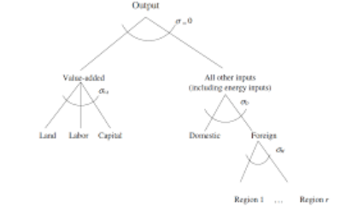
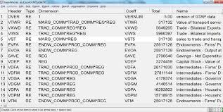
Why is the topic even important?
Also see Simonovska and Waugh (JIE, 2013) and Hillberry and Hummels (HBC, 2012)

Slide 3
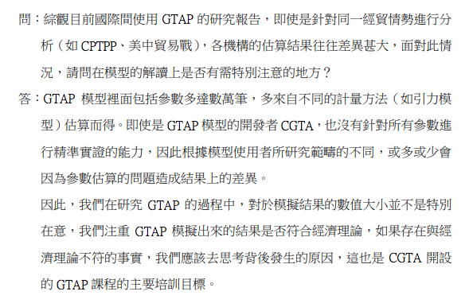
A Report by NDC (Taiwan) Noting the Importance of our Parameter Estimates used in the Simulation Analysis

Slide 4
Roadmap of the Lecture
Introduction: Concept and Graphical Illustration
Estimation: General Equilibrium (GE) vs. Partial Equilibrium (PE)
Demand System Estimation in GTAP (PE) – applying to CGEMs
Demand System Estimation of MAIDADS (PE)
Example of MAIDADS Estimation vs. Calibration
Example of unconventional calibration process: Estimation “obviously” contains calibration
Structural Gravity Estimation (GE); e.g., NQTMs
Example of use of theory to establish identifying equilibrium constraints
Estibration: Illustration of Structural Estimation as Calibration
Summary and Future Directions

Slide 5
Roadmap of the Lecture
Introduction: Concept and Graphical Illustration
Estimation: General Equilibrium (GE) vs. Partial Equilibrium (PE)
Demand System Estimation in GTAP (PE)
Demand System Estimation of MAIDADS (PE)
Example of MAIDADS Estimation vs. Calibration
Example of unconventional calibration process: Estimation “obviously” contains calibration
Structural Gravity Estimation (GE)
Example of use of theory to establish identifying equilibrium constraints
Estibration: Illustration of Structural Estimation as Calibration
Summary and Future Directions

Slide 6
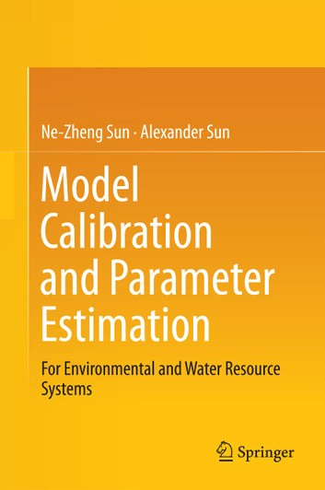
Introduction: Estimation and Calibration
Parameter Estimation
Process of Using Data to Estimate Parameters of Selected Models
Can both be on the demand and supply side
Estimation may contain calibration process; we will see examples later on
Why do we want parameters to be estimated?
Calibration of Economic Models
Process of Fitting Parameters of Selected Models into Data
We are endowed with specific known dataset to be fitted
Like estimation problems; can both be on the demand and supply side
Why do we want models to be calibrated?
Both fit a model to data (Balistreri and Hillberry, 2005)
Notes:
It is sometimes very easy to get confused; under some circumstances, it is very hard to distinguish these two categories of economic analysis/method. For the calibration, we are endowed with rich set of the real-world data to fit the best possible model that we have. Calibration of parameters allow the model to fit the data exactly. For the estimation, the identification of model parameters yields “Deep” parameters and help with counterfactual simulation

Slide 7
Introduction: Fitting a Model to Data
Model Estimation
Parameter Estimates
Model Calibration
Model
Model Simulation
Data

Slide 8
Roadmap of the Lecture
Introduction: Concept and Graphical Illustration
Estimation: General Equilibrium (GE) vs. Partial Equilibrium (PE)
Demand System Estimation in GTAP (PE)
Demand System Estimation of MAIDADS (PE)
Example of MAIDADS Estimation vs. Calibration
Example of unconventional calibration process: Estimation “obviously” contains calibration
Structural Gravity Estimation (GE)
Example of use of theory to establish identifying equilibrium constraints
Estibration: Illustration of Structural Estimation as Calibration
Summary and Future Directions

Slide 9
Estimation: GE vs. PE Constraints
Private Household Demand System Estimation in GTAP
GTAP Database, World Bank ICP
Use of Constrained Optimization and Econometrics (but less “structural”)
Use of Economic Theory (but only on the demand side; PE)
Depending on the problem, may or may not need cutting-edge algorithms
Structural Estimation of Gravity GE Models
WIOD Database, CEPII
Use of Constrained Optimization and Econometrics
Use of Economic Theory (GE and Complementarity Conditions)
Use of Advanced Mathematical Algorithms (e.g., MPEC)
Notes:
Complementarity condition in this case is formulated in the computer as what is called “MCP” – mixed complementarity problem. It can be dated back to the theory of Arrow-Debreu general equilibrium but is re-formulated by Mathiesen (1985). References: BH estibration paper; Rutherford (1995).

Slide 10
Estimation: GE vs. PE Constraints
Private Household Demand System Estimation in GTAP
GTAP Database, World Bank ICP
Use of Constrained Optimization and Econometrics (but less “structural”)
Use of Economic Theory (but only on the demand side; PE)
Depending on the problem, may or may not need cutting-edge algorithms

Slide 11
Demand System Estimation in GTAP
Constant Difference of Elasticities (CDE)
Originated from Hanoch (1975)
It has only been estimated as a production function (e.g., Surry, 1993)
CDE as a demand function has never been directly estimated before
Calibrated; e.g., Liu, Surry, Dimaranan and Hertel (2001), Chen (2017)
Yang, Preckel (2019)
Focus on econometrics and normalization strategy
Optimization with Iterated Least Squares as objective function
Yang, Preckel, Hertel and van der Mensbrughe (2019)
Focus on application and benefits in the GTAP community
Maximum Likelihood Estimation (MLE)
Very important but hard to deal with
Notes:
Very important in terms of identification but not easy to deal with, especially if we are talking about the highly non-linear systems. Operational researchers, policy analysts, subject matter experts (like trade economists) may have different interests regarding normalization

Slide 12
Demand System Estimation in GTAP
It is implicitly indirectly defined as:
$$G\left(\frac{p}{w},u\right)=\sum_{k}{β_{k}u^{e_{k}\left(1−α_{k}\right)}{(\frac{p_{k}}{w})}^{1−α_{k}}≡1}$$
Highly non-linear, difficult to solve
We first find feasible starting values to categorize the implicit relationship.
We show analytically the existence of the most approximated initial guess.
We establish normalization strategy to remove spare degrees of freedom.
We calculate the cardinal value of utility to identify behavioral parameters.

Slide 13
Main Problems of the CDE
CDE is a flexible demand system
Key: it removes the dependence of substitution effects on income effects
Still a restrictive functional form (e.g., substitution matrix )
That is ok; it is more general than most of the demand systems.
Issues:
Luxury goods stay as luxury goods as income grows
Question:
In terms of expenditure shares, do we really buy more “Lamborghini” as we are richer?
Think about long-term projection: How spending patterns will evolve?

Slide 14
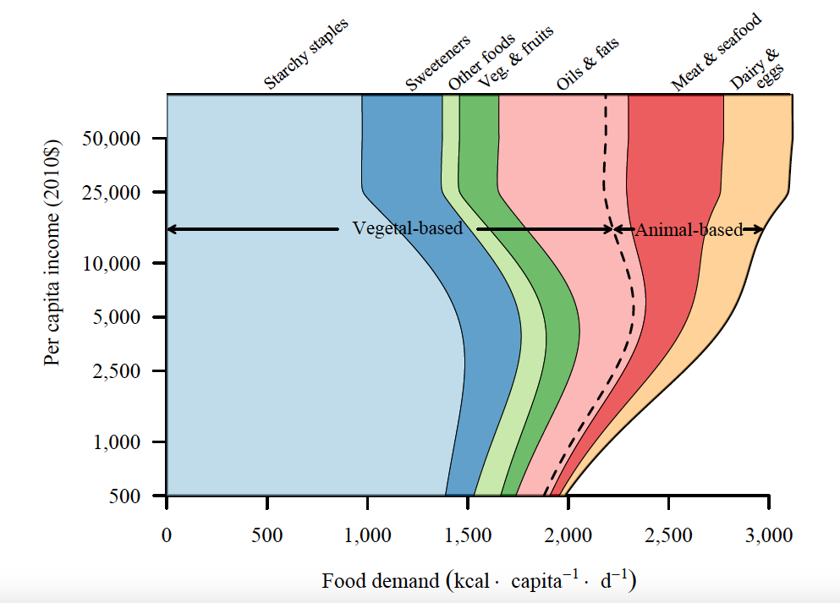
Demand System Estimation of MAIDADS
MAIDADS Estimation
Gouel and Guimbard (AJAE, 2018), Yang, Gouel and Hertel (2019)
Objective function: constrained MLE
Constraint: theory-consistent demand equation
Parametric restriction: regularity condition
MAIDADS Caloric Demand System
Proposed by Preckel, Cranfield and Hertel (2010)
Could be useful for CGE models if growth of income is important (Aguiar, Corong, and van der Mensbrugge, 2019)
(don’t want the income to be too high!! Why?)
Source: Gouel and Guimbard (AJAE, 2018)

Slide 15
Prediction of MAIDADS Elasticities
Source: Yang, Gouel and Hertel (2019)

Slide 16
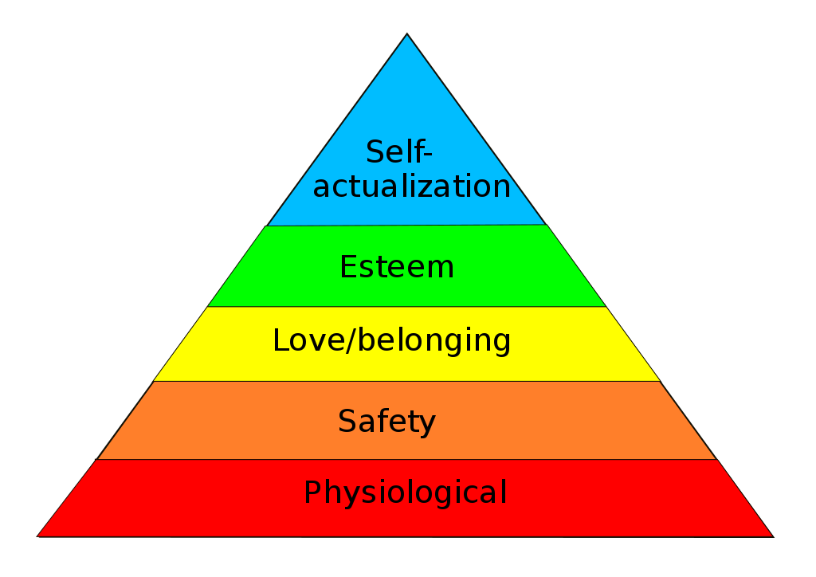
Prediction of MAIDADS Elasticities
Collapsing to “satiation”!
Meaning: We don’t need no more food!!!
Source: Yang, Gouel and Hertel (2019)

Slide 17
MAIDADS Estimation
$$\max_{\begin{aligned}ω≥0, κ,α_{i},β_{i},δ_{i}, \\ τ_{i}≥0,{\hat{x}}_{ci}>0,u_{c},ε_{ci},r_{ij}\end{aligned}}{−\frac{C}{2}\left[I\left(1+\log{2π}\right)+\log{\prod_{i=1}^{I}{r_{ii}^{2}}}\right]}$$
$s.t.$
(1) ${\hat{x}}_{ci}=\underset{Subsistence Caloric Consumption}{\underbrace{\frac{δ_{i}+τ_{i}e^{ωu_{c}}}{1+e^{ωu_{c}}}}}+\underset{Discretionary Caloric Consumption}{\underbrace{\overset{Marginal Budget Share}{\overbrace{\frac{α_{i}+β_{i}e^{u_{c}}}{1+e^{u_{c}}}}}\frac{1}{p_{k,r}}\left(m_{c}−\sum_{j}{p_{cj}\underset{Subsistence Caloric Consumption}{\underbrace{\frac{δ_{j}+τ_{j}e^{ωu_{c}}}{1+e^{ωu_{c}}}}}}\right)}}$
(2) $\sum_{i=1}^{I}{α_{i}}=\sum_{i=1}^{I}{β_{i}}=1$
(3) $\sum_{i=1}^{I}{\frac{α_{i}+β_{i}e^{u_{c}}}{1+e^{u_{c}}}\log{({\hat{x}}_{ci}−\frac{δ_{j}+τ_{j}e^{ωu_{c}}}{1+e^{ωu_{c}}})}}−u_{c}=κ$
(4) $x_{ci}={\hat{x}}_{ci}+ε_{ci}$
(5) $\sum_{c=1}^{C}{\frac{ε_{ci}ε_{cj}}{C}=\sum_{k=1}^{I}{r_{ki}r_{kj}},r_{ij}=0 ∀j>i}$
generalized version of LES

Slide 18
Estimation vs. Calibration: Demand Side
MAIDADS Estimation
Gouel and Guimbard (AJAE, 2018), Yang, Gouel and Hertel (2019)
Objective function: constrained maximum likelihood
Constraint: theory-consistent demand equation
Parametric restriction: regularity condition
MAIDADS Calibration
Itakura and van der Mensbrugghe (GTAP, 2011)
Objective function: “least squares”
Constraint: theory-consistent demand equation
Parametric restriction: regularity condition

Slide 19
MAIDADS Calibration – one standard procedure
Post-Estimation (“r” index region; omitted in the constraints):
$s.t.$
(1) ${\hat{s}}_{i}=\frac{(\tilde{δ_{i}}+\tilde{τ_{i}}e^{\tilde{ω}\tilde{u}}){\hat{p}}_{i}}{(1+e^{\tilde{ω}\tilde{u}})\hat{c}}+\frac{({\tilde{α}}_{i}+{\tilde{β}}_{i}e^{\tilde{u}}){\hat{p}}_{i}}{(1+e^{\tilde{ω}\tilde{u}})\hat{c}}\left(\hat{c}−\sum_{j}^{n}{{\hat{p}}_{j}\frac{\tilde{δ_{j}}+\tilde{τ_{j}}e^{\tilde{ω}\tilde{u}}}{1+e^{\tilde{ω}\tilde{u}}}}\right)$
(2) $\sum_{i}^{n}{{\tilde{α}}_{i}=1}$, $\sum_{i}^{n}{{\tilde{β}}_{i}=1}$
(3) ${\hat{x}}_{i}>\frac{\tilde{δ_{i}}+\tilde{τ_{i}}e^{ωu}}{1+e^{ωu}}≥0$, where ${\hat{s}}_{i}={\hat{p}}_{i}{\hat{x}}_{i}/{\hat{c}}_{i}$
(4) $\tilde{ω}>0$,${ \tilde{α}}_{i},{\tilde{β}}_{i},{\tilde{δ}}_{i},{\tilde{τ}}_{i}≥0 ∀i$
“hat” means observed from the data
Choosing
Notes:
We are fitting parameters of selected models into data (in this case the S-hat), but are we really doing the estimation or calibration here?

Slide 20
MAIDADS Calibration -an “unconventional” way
$$\min_{u, ω,α,β,δ,τ}{\sum_{i}^{n}{{\left(\frac{s_{i}}{{\hat{s}}_{i}}−1\right)}^{2}}}$$
$s.t.$
(1) $s_{i}=\frac{(δ_{i}+τ_{i}e^{ωu}){\hat{p}}_{i}}{(1+e^{ωu})\hat{c}}+\frac{(α_{i}+β_{i}e^{u}){\hat{p}}_{i}}{(1+e^{ωu})\hat{c}}\left(\hat{c}−\sum_{j}^{n}{{\hat{p}}_{j}\frac{δ_{j}+τ_{j}e^{ωu}}{1+e^{ωu}}}\right)$
(2) $\sum_{i}^{n}{α_{i}=1}$, $\sum_{i}^{n}{β_{i}=1}$
(3) ${\hat{x}}_{i}>\frac{δ_{i}+τ_{i}e^{ωu}}{1+e^{ωu}}≥0$, where ${\hat{s}}_{i}={\hat{p}}_{i}{\hat{x}}_{i}/{\hat{c}}_{i}$
(4) $ω>0$, $α_{i}, β_{i}, δ_{i}, τ_{i}≥0 ∀i$
It may be viewed as an estimation problem containing calibration!
Observed expenditure shares
Source: Itakura and van der Mensbrugghe (GTAP, 2011)
Notes:
We are fitting parameters of selected models into data (in this case the S-hat), but are we really doing the estimation or calibration here?

Slide 21
Estimation: GE vs. PE Constraints
Private Household Demand System Estimation in GTAP
GTAP Database, World Bank ICP
Use of Constrained Optimization and Econometrics (but less “structural”)
Use of Economic Theory (but only on the demand side; PE)
Depending on the problem, may or may not need cutting-edge algorithms
Structural Estimation of Gravity GE Models
WIOD Database, CEPII
Use of Constrained Optimization and Econometrics
Use of Economic Theory (GE and Complementarity Conditions)
Use of Contemporary Mathematical Algorithms (e.g., MPEC)

Slide 22
Estimation: GE vs. PE Constraints
Structural Estimation of Gravity GE Models
WIOD Database, CEPII
Use of Constrained Optimization and Econometrics
Use of Economic Theory (GE and Complementarity Conditions)
Use of Advanced Mathematical Algorithms (e.g., MPEC)

Slide 23
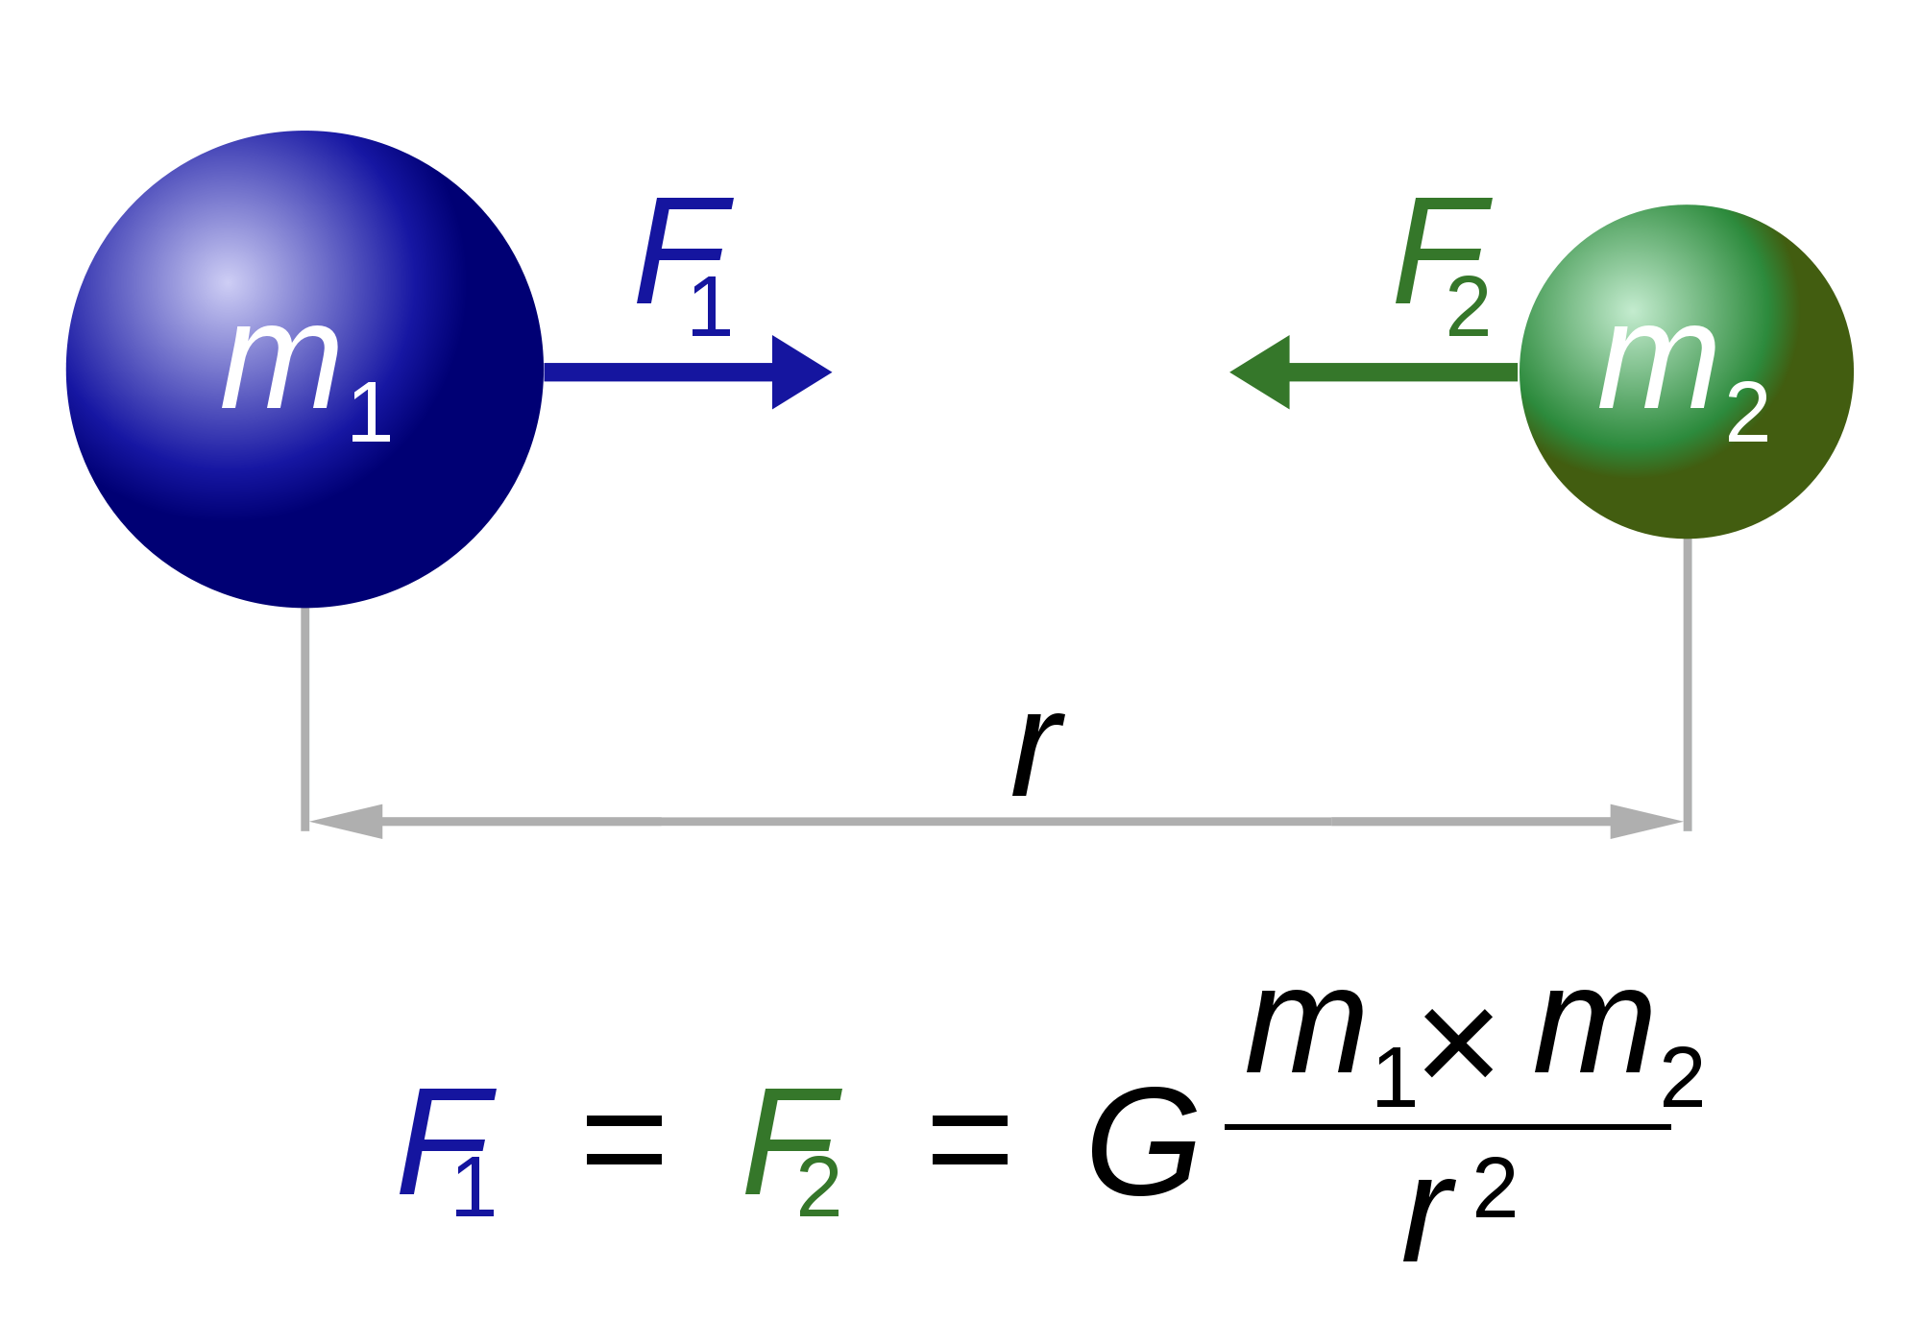
Gravity Model of International Trade (1995 WIOD)
Size
Size
Distance
Source: Yang (2019)
Notes:
F₁₂ is the magnitude of the gravitational force acting between masses M₁ and M₂ separated by distance r₁₂. The force equals the product of these masses and of G, a universal constant, divided by the square of the distance.

Slide 24
Structural Gravity Estimation
Yang (2019) – CDE-Gravity Model
Hillberry and Yang (2019) (HY) – Implicit CES-Gravity Model
Both papers employ MPEC-NLPEC algorithm
Solve the objective function subject to equality/inequality constraints
Constrained optimization – Poisson Pseudo Maximum Likelihood (PPML)
HY constructs an operational GE 3n system of equations
The 3n equations are then formulated as constraints.
Sometimes we need to establish theory to identification
In this case, 1n equation is constructed using demand theory

Slide 25
Structural Gravity Estimation
We solve the duality of explicitly direct CES function to generate implicitly indirect CES representation
(1) Starting from the explicit CES function:
$$U_{j}≡{\left[\sum_{i}{{α_{i}}^{\frac{1−σ}{σ}}}{\left(\frac{T_{ij}}{τ_{ij}}\right)}^{\frac{1−σ}{σ}}\right]}^{\frac{σ}{σ−1}}$$
(2) Solving for nominal trade flows equation:
$${FOB}_{i}T_{ij}=Y_{j}{(\frac{α_{i}{FOB}_{i}τ_{ij}}{P_{j}})}^{1−σ}$$
Think about this term as a quantity “Q”
Consumer in “j” wants $T_{ij}$
Iceberg Theory: Quantity gets melted because of shipping costs

Slide 26
Structural Gravity Estimation
1n equation
(3) We plug the definition for the exact price index,
$$U_{j}=\frac{Y_{j}}{P_{j}}$$
into the nominal trade flow equation, and obtain
$${FOB}_{i}T_{ij}={U_{j}}^{1−σ}{(α_{i}τ_{ij})}^{1−σ}{{FOB}_{i}}^{1−σ}{Y_{j}}^{σ}$$
(4) We show that the national income is represented by the total
expenditure of CIF goods, therefore
$Y_{j}=\sum_{i}{{FOB}_{i}T_{ij}=\sum_{i}{{U_{j}}^{1−σ}{(α_{i}τ_{ij})}^{1−σ}{{FOB}_{i}}^{1−σ}{Y_{j}}^{σ}}}$
(5) Finally, dividing by $Y_{j}$ on both sides, we get
$$\sum_{i}{{α_{i}}^{1−σ}{U_{j}}^{1−σ}}{(\frac{{FOB}_{i}τ_{ij}}{Y_{j}})}^{1−σ}≡1$$
1n equation
1n equation
This is simply an Armington representation of GE shown as one example. EK is indeed possible!

Slide 27
Structural Gravity Estimation
What are we trying to fit? What are we missing? Why?
If we simply regress trade flows on income…
We would get biased estimates!
This is because utility is unobserved and other structural parameters are not controlled for.
HY formulation of the problem and the MPEC allow utility and the structural parameters to be uncovered.

Slide 28
Roadmap of the Lecture
Introduction: Concept and Graphical Illustration
Estimation: General Equilibrium (GE) vs. Partial Equilibrium (PE)
Demand System Estimation in GTAP (PE)
Demand System Estimation of MAIDADS (PE)
Example of MAIDADS Estimation vs. Calibration
Example of unconventional calibration process: Estimation “obviously” contains calibration
Structural Gravity Estimation (GE)
Example of use of theory to establish identifying equilibrium constraints
Estibration: Illustration of Structural Estimation as Calibration
Summary and Future Directions

Slide 29
Estibration – Estimation and Calibration
An Illustration of Structural Estimation as Calibration
Balistreri and Hillberry (2005)
e.g., Gravity Models
“Contemporary Economic analysis includes two broad traditions of fitting models to data. Many estimate stochastic, theory-based, reduced forms with few parameters, while others calibrate models by an extensive collection, and computation, of consistent fitted values.”
e.g., SIMPLE-G Model
e.g., GTAP/CGE Models
e.g., GTAP/CGE Models
See Costinot and Rodriguez-Clare Handbook Chapter

Slide 30
Estibration
Balistreri and Hillberry coined this term
Replicates empirical work of Anderson and van Wincoop (2003)
Early lit. in Dawkins et al. in the Handbook of Econometric
Estimation is calibration; calibration is estimation
Estimating and calibrating the AvW model are equivalent methods for fitting the model to data

Slide 31
Estibration
Methods
Language
BH builds a bridge
between the methods and language used by modelers who calibrate systems regularly and those who use econometric methods
Estimators
Calibrators

Slide 32
Estibration: Fitting a Model to Data
Consistent Identifying Assumptions
Parameter Estimates
Model Estibration
Model
Model Simulation
Data

Slide 33
Summary and Future Directions
Estimation and calibration are two traditions of fitting models to data
Estimation is important: Identification of model parameters yields “Deep” (so-called) parameters which help with counterfactual simulations; e.g., the structural gravity/NQTMs
Calibration allows the model to fit the data exactly
We need both traditions for economic analysis
Estibration: Under consistent identifying assumptions (e.g., structural and parametric restrictions), estimation is calibration
We may bridge NQTMs with CGEMs using the concept of Estibration
We may compute the GTAP Model with the structural approach
This is an Arkolakis’ suggestion
We may combine the structural approach with Dekle, Eaton & Kortum
Another suggestion from Arkolakis (e.g., GTAP-DEK)
Global approximation instead of local

Slide 34
Estimation and Calibration in Global GE Models
Please take a moment to complete the evaluation for this presentation.
Thank you!

